Slide 1
CS105.3
Database Management Systems
Manoja Weerasekara

Slide 2
What we have discussed so far:
Data
Information
Why we store Data
Manual Databases
Database Applications
2

Slide 3
Today.. Learning Objectives
In this lecture, you will learn:
Types of Data Processing
Basic file terminology
About data modeling and why data models are important
About the basic data-modeling building blocks
What are business rules are and how they influence database design
2

Slide 4
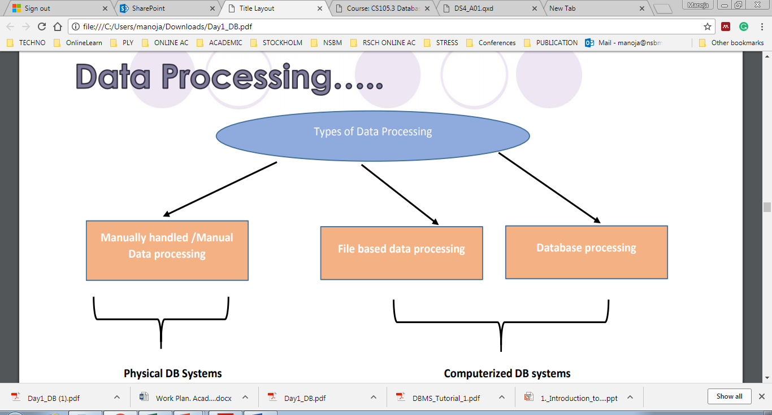

Slide 5
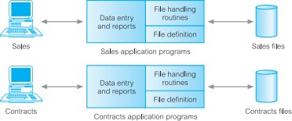
File based systems:
Data is stored in files
Each file has a specific format
Programs that use these files depend on knowledge
about that format

Slide 6
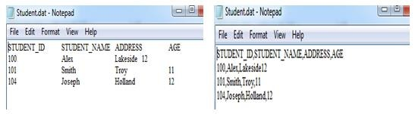
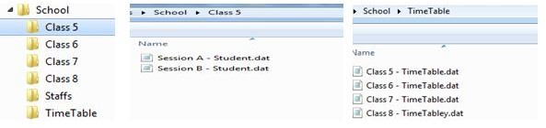
File Processing Systems

Slide 7
Disadvantages of file processing
Limited data Mapping and Access
Data Redundancy
Data Dependence
Data inconsistency
Data Isolation
Security is less
Integrity is limited
Concurrent Access is limited

Slide 8
Database Concepts
The need of database systems arose in the early 1960s in response to the traditional file processing system.
In the database approach, the data is stored in the form of files, and a number of application programs are written by programmers to add, modify, delete, and retrieve data to and from appropriate files.
Traditional database applications vs. Big data storage systems, or NOSQL systems
provide cloud storage

Slide 9
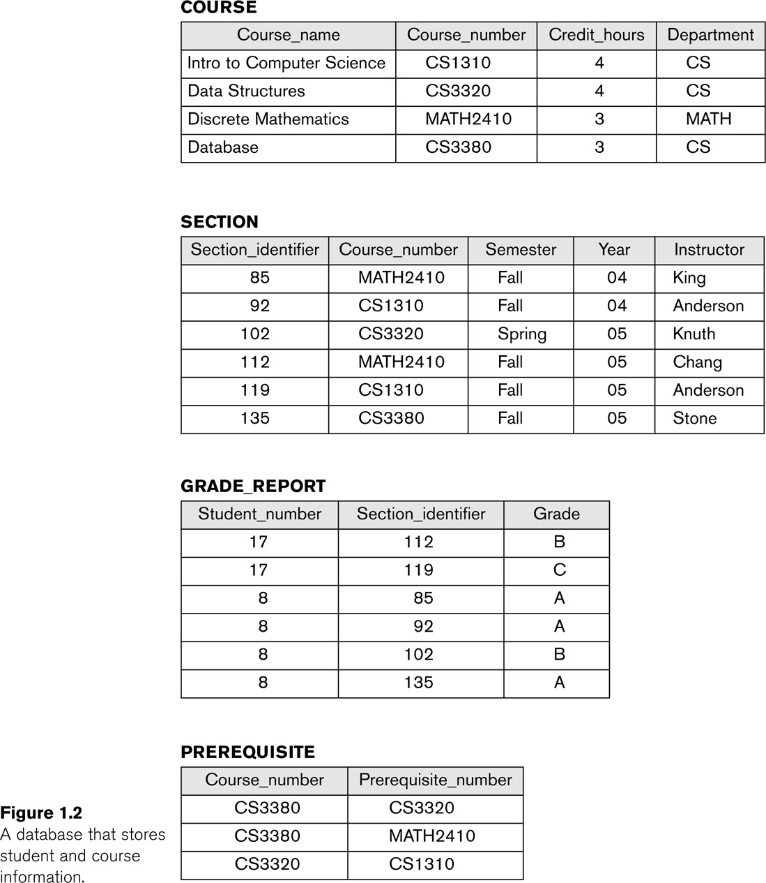
Example of a simple database

Slide 10
Things to be remembered…
A database..
Is a miniworld.
Is a logically coherent collection of data with some
inherent meaning.
Is designed, built, and populated with data for a specific purpose.
Collection of related data

Slide 11
Characteristics of the Database Approach
■ Self-describing nature of a database system
■ Insulation between programs and data, and data abstraction
■ Support of multiple views of the data
■ Sharing of data and multiuser transaction processing

Slide 12
Data Hierarchy
Database
Files
Records
Fields
Characters (Bytes)
Bits

Slide 13
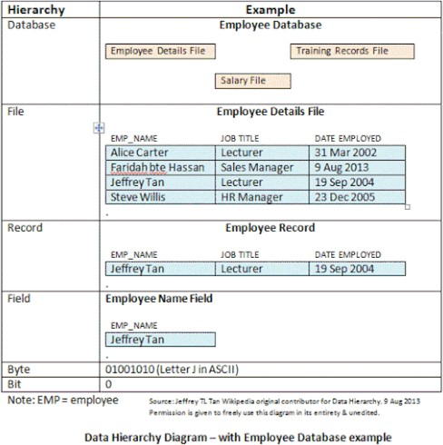
Basic File Terminology
13

Slide 14
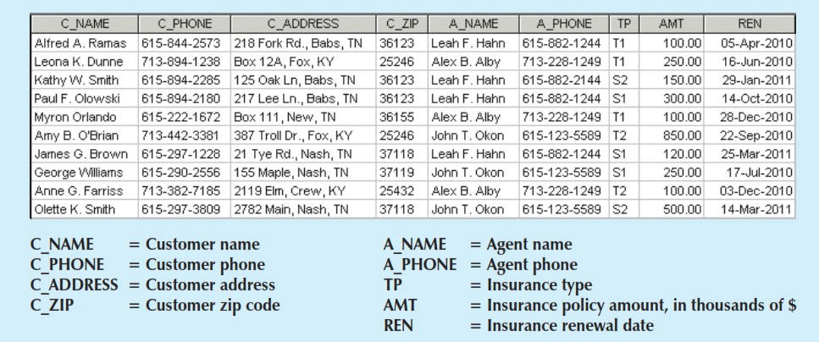
Sample Basic File
14

Slide 15

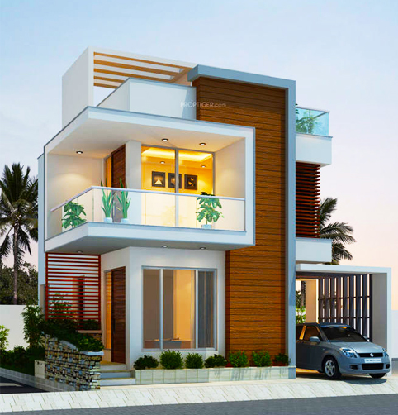
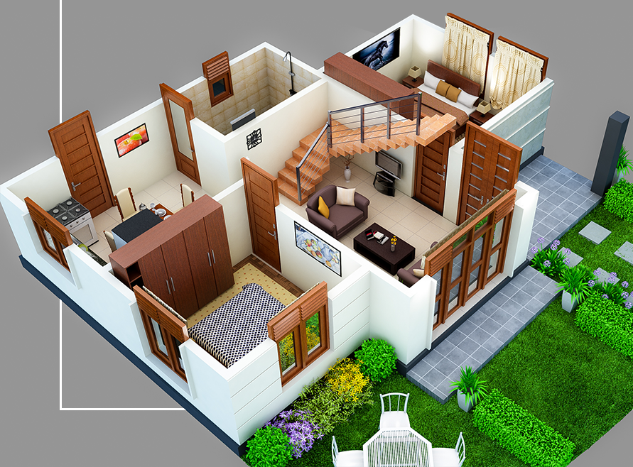

Slide 16
Data Modeling and Data Models
Model - Abstraction of a real-world object or event
Data models: Simple representations of complex real-world data structures
Useful for supporting a specific problem domain
Data modeling: Iterative and progressive process of creating a specific data model for a determined problem domain
16

Slide 17
Importance of Data Models
Are a communication tool
Give an overall view of the database Organize data for various users
Are an abstraction for the creation of good
database
17

Slide 18
Categories of Data Models
High-level or conceptual data models:
provide concepts that are close to the way many users perceive data (E.g. Entity-Relationship Model)
Low-level or physical data models:
provide concepts that describe the details of how data is stored on the computer storage media, typically magnetic disks.
Representational (or implementation) data models:
provide concepts that may be easily understood by end users but that are not too far removed from the way data is organized in computer storage.
E.g. (Relational Model, Hierarchical Model, Network Model, OO Model, etc.)

Slide 19
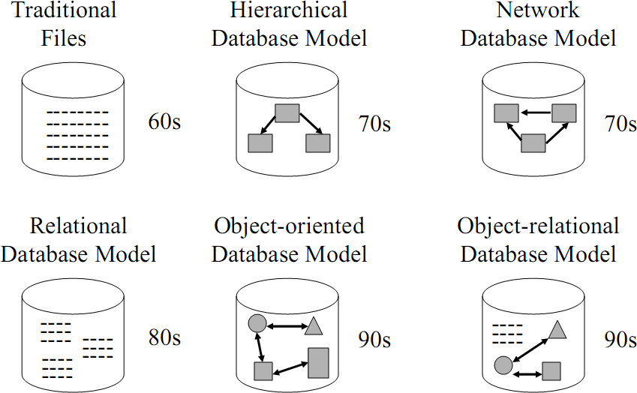
Types of Database Models

Slide 20
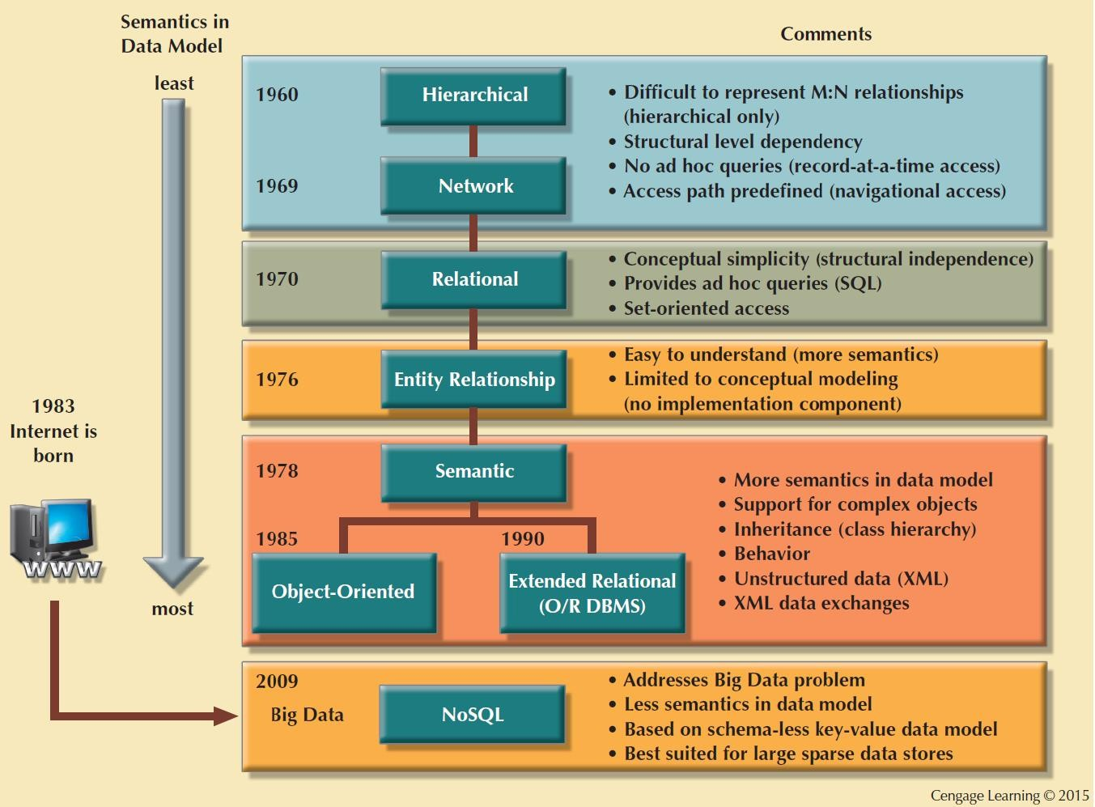
The Evolution of Data Models
14

Slide 21
Flat model
The flat model consists of a single, two-dimensional array of data elements, where all members of a given column are assumed to be similar values, and all members of a row are assumed to be related to one another.
Columns of the table often have a type associated with them, defining them as character data, date or time information, integers, or floating point numbers.

Slide 22
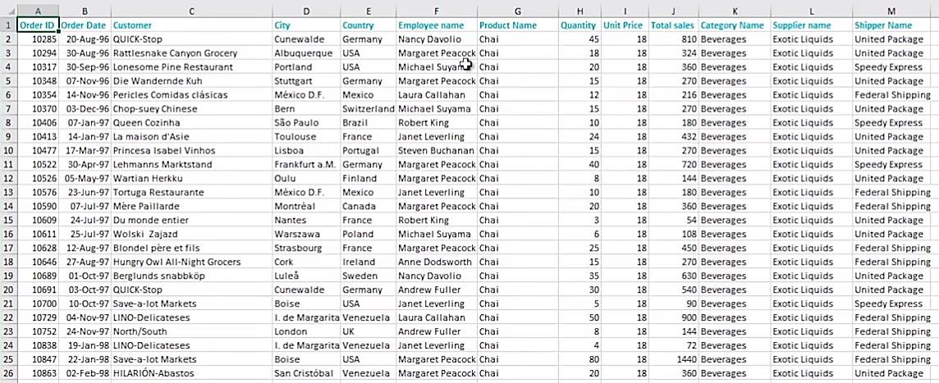
Example: Flat Model

Slide 23
Data Redundancy
Unnecessarily storing same data at different places
Islands of information: Scattered data locations
Increases the probability of having different versions of the same
data
Implications
Poor data security
Data inconsistency
Increased likelihood of data-entry errors when complex entries are made in different files
Data anomaly: Develops when not all of the required changes in the redundant data are made successfully

Slide 24




Types of Data Anomaly
Update Anomalies
Insertion Anomalies Deletion Anomalies

Slide 25
Exercise
How many records does the file contain? How many fields are there per record?
What problem would you encounter if you wanted to produce a listing by city? How would you solve this problem by altering the file structure?
If you wanted to produce a listing of the file contents by customer last name how would you alter the file structure?
What data redundancies do you detect? How could those redundancies lead to anomalies?
19

Slide 26
Hierarchical Model
Data is organized into a tree-like structure, implying a single upward link in each record to describe the nesting, and a sort field to keep the records in a particular order in each same-level list
Hierarchical structures were widely used in the early mainframe database management systems,
This structure allows one 1:M relationship between two types of data. This structure is very efficient to describe many relationships in the real world.

Slide 27
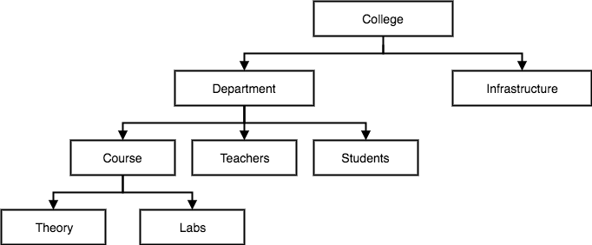
Example: Hierarchical model

Slide 28
Network Data Model
An extension of the Hierarchical model. Data is organized more like a graph, and are allowed to have more than one parent node.
Improve database performance and impose a database standard.
Depicts both one-to-many (1:M) and many-to-many (M:N)
relationships.
This was the most widely used database model, before Relational Model was introduced.

Slide 29
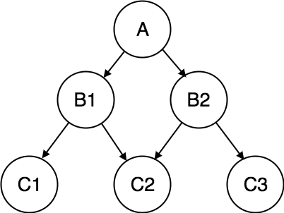
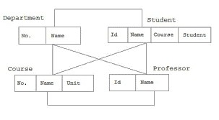
Example: Network model

Slide 30
The Object-Oriented Data Model (OODM) or Semantic Data Model
Object: Contains data and their relationships with operations that are performed on it
Basic building block for autonomous structures
Abstraction of real-world entity
Attributes - Describe the properties of an object
Methods – Describe the behavior of an object

Slide 31
The Object-Oriented Data Model (OODM)
Class: Collection of similar objects with shared structure and behavior organized in a class hierarchy
Class hierarchy: Resembles an upside-down tree in which each class has only one parent
Inheritance: Object inherits methods and attributes of parent class

Slide 32
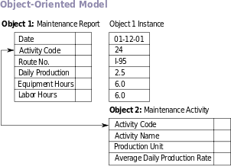
Example: Object Oriented model

Slide 33
The Relational Model
Foundation is a mathematical concept known as a relation
Based on a relation
Relation or table: Matrix composed of intersecting tuple and attribute
Tuple: Rows
Attribute: Columns
The relationship is maintained by storing a common field.

Slide 34
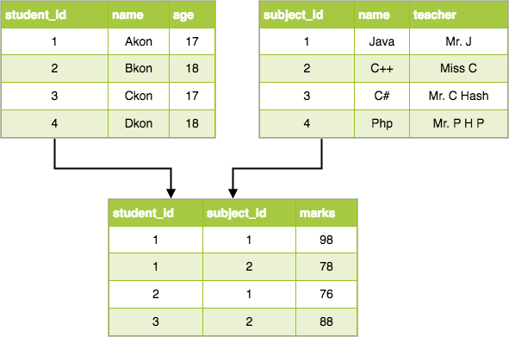
Example: Relational Model

Slide 35
Relational Model [Properties]
Each relation (or table) in a database has a unique name
An entry at the intersection of each row and column is atomic (or single-valued)
Each row is unique; No two rows in a relation are identical
Each attribute (or column) within a table has a unique name

Slide 36
Relational Objects
Tables are comprised of rows and a fixed number of named columns.
Data is presented to the user as tables:
Column 1 | Column 2 | Column 3
Row 1
Row 2
Row 3

Slide 37
Relational Objects
Columns are attributes describing an entity. Each column must have an unique name and a data type.
Structure of a relation (e.g. Employee) Employee(Name, Designation, Department)
Name | Designation | Department
Employee

Slide 38
Relational Objects
Rows are records that present information about a particular entity occurrence
Employee
Name | Designation | Department
Jason | Software Engineer | SE
Shavantha | DA Engineer | DA
Roshni | Solution Engineer | BS

Slide 39
Relational model terminology
Row is called a ‘tuple’
Column header is called an ‘attribute’
Table is called a ‘relation’
The data type describing the type of values that can appear in
each column is called a ‘domain’
E.g.
Employee ages: value between 15 & 80 years old
The above is called ‘logical definitions of domains’.
A data type or format can also be specified for each domain.
e.g. The employee age is an integer between 15 and 80

Slide 40
Relational Model [Properties]
The sequence of columns (left to right) is insignificant;
The columns of a relation can be interchanged without changing the meaning or use of the relation
The sequence of rows (top to bottom) is insignificant;
Rows of a relation may be interchanged or stored in any sequence

Slide 41
Relational constraints
Domain constraints
specifies that the value of each attribute ‘A 'must be an atomic value.
And from the specified domain
Key constraints
There is a sub set of attributes of a relational schema with the property that no two tuples should have the same combination of values for the attributes.

Slide 42
Relational Model
Advantages
Disadvantages
Structural independence is promoted using independent tables
Tabular view improves
conceptual simplicity
Ad hoc query capability is based on SQL
Isolates the end user from physical-level details
Improves implementation and management simplicity
Requires substantial hardware and system software overhead
Conceptual simplicity gives untrained people the tools to use a good system poorly
May promote information problems

Slide 43
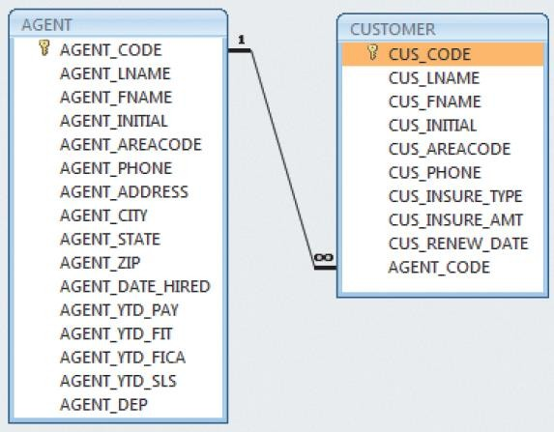
A Relational Diagram

Slide 44
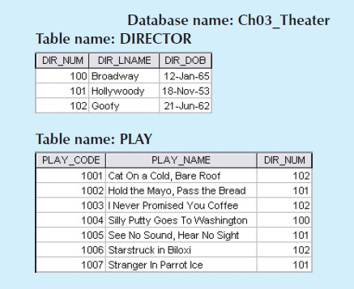
Exercise
Create the relational diagram to show the relationship between DIRECTOR and PLAY.

Slide 45
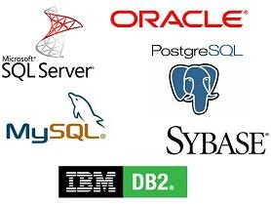
Relational Database Management System(RDBMS)
A collection of programs and capabilities that enable IT teams and others to create, update, administer and otherwise interact with a relational database.
Most commercial RDBMS use Structured Query Language
(SQL) to access the database.
Makes the relational data model easier to understand and
implement

Slide 46
Standard Database Concepts
Schema
Conceptual organization of the entire database as viewed by
the database administrator
Subschema
Portion of the database seen by the application programs that produce the desired information from the data within the database

Slide 47
Standard Database Concepts
Data manipulation language (DML)
Environment in which data can be managed and is used to work with the data in the database
Schema data definition language (DDL)
Enables the database administrator to define the schema components

